Slide 1

EXPENSE TRACKER
Gain Control of Your Spending with Our Expense Tracker Solution.

Slide 2
Team & Project Identity
Team Name : Kotlin Fusion
karakambadi Durga Sai , durga.23bce9407@vitapstudent.ac.in , 8977258631
Team Member
Registration No.
Batch
Department
Year
K.Durga Sai
23BCE9407
BATCH 2
CSE
2nd year
P.Tejpraneeth
23BCE9500
BATCH 2
CSE
2nd year
M.Mahendra
23BCE20003
BATCH 2
CSE
2nd year

Slide 3
TEAM CONTRIBUTION
Name | Contribution Area
k . Durga sai | Kotlin,Room Database,DAO (Data Access Object) Data Class,ViewBinding,Kotlin Coroutines Snackbar,MVC Architecture
P . Tejpraneeth | Activities,Input Validation,Material Design Layouts Navigation between screens
M . Mahendra | RecyclerView,Card Layout Design,Icons and Color Coding,UI Testing and Improvements

Slide 4
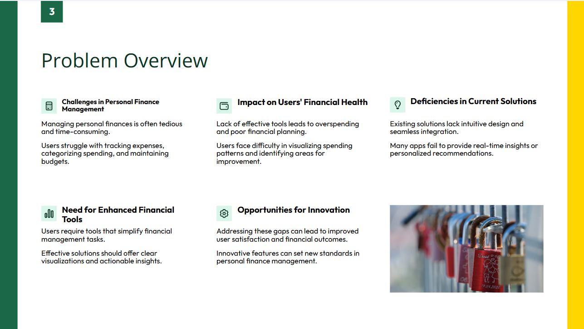

Slide 5
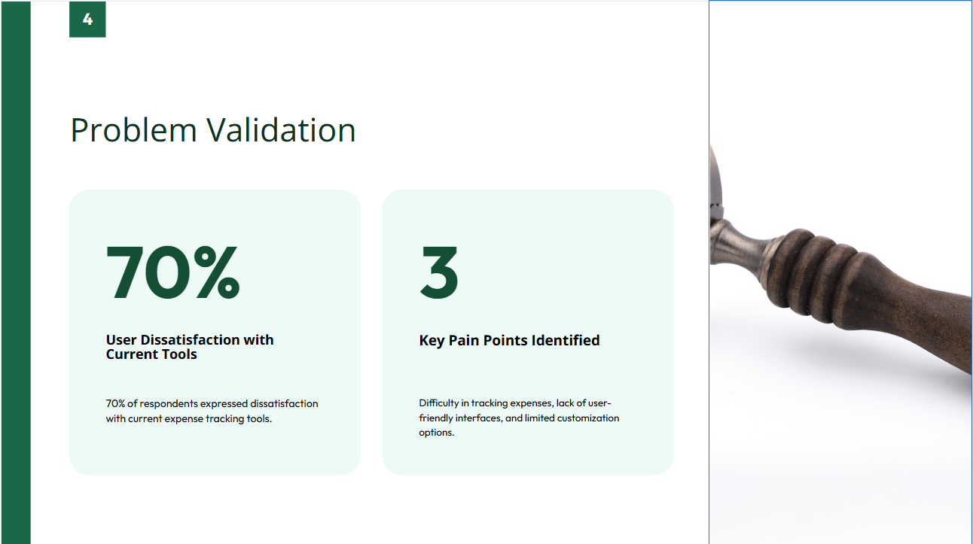

Slide 6
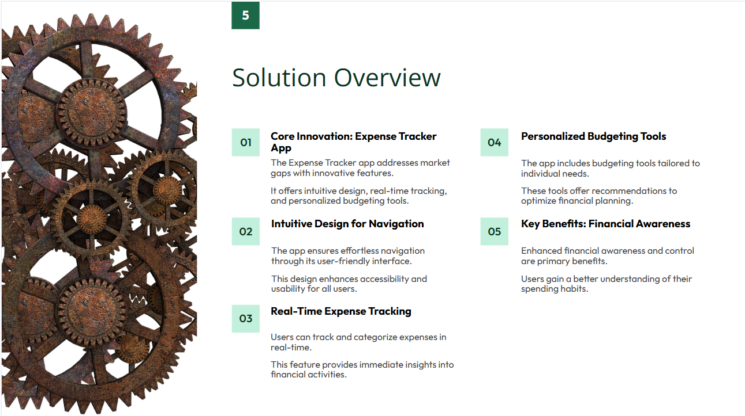

Slide 7
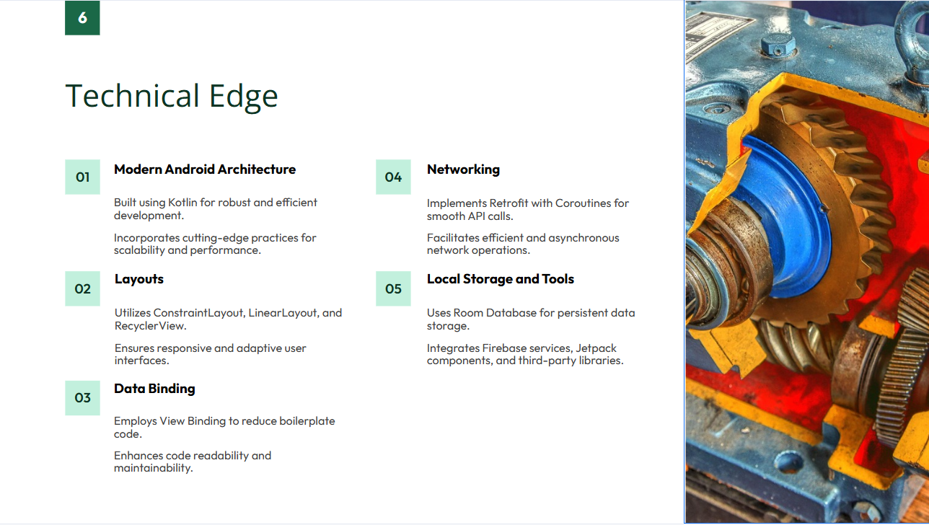

Slide 8
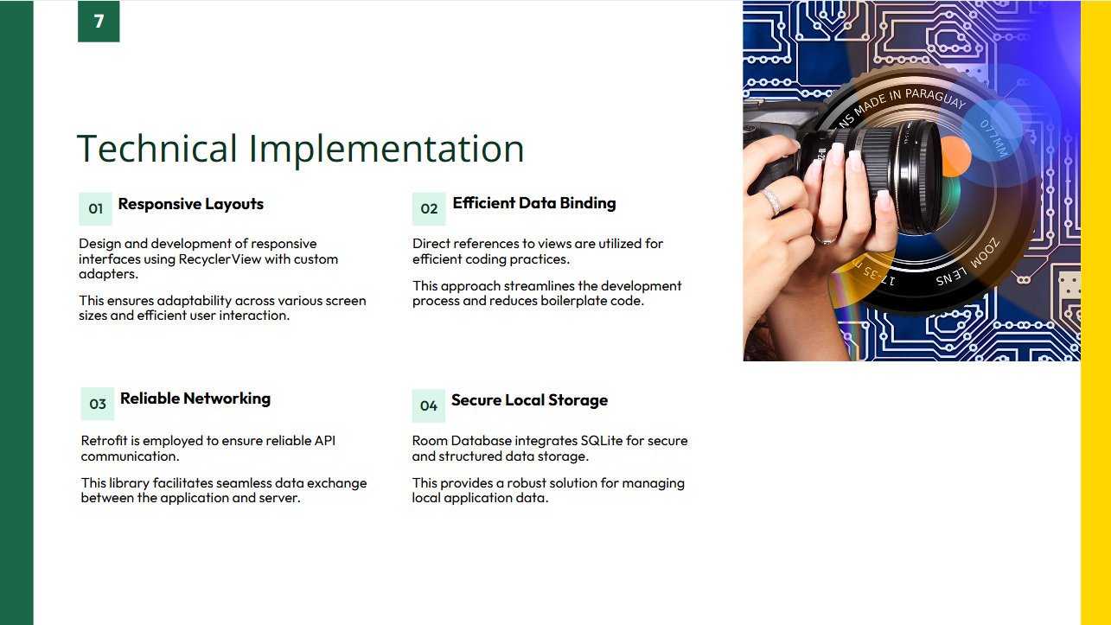

Slide 9
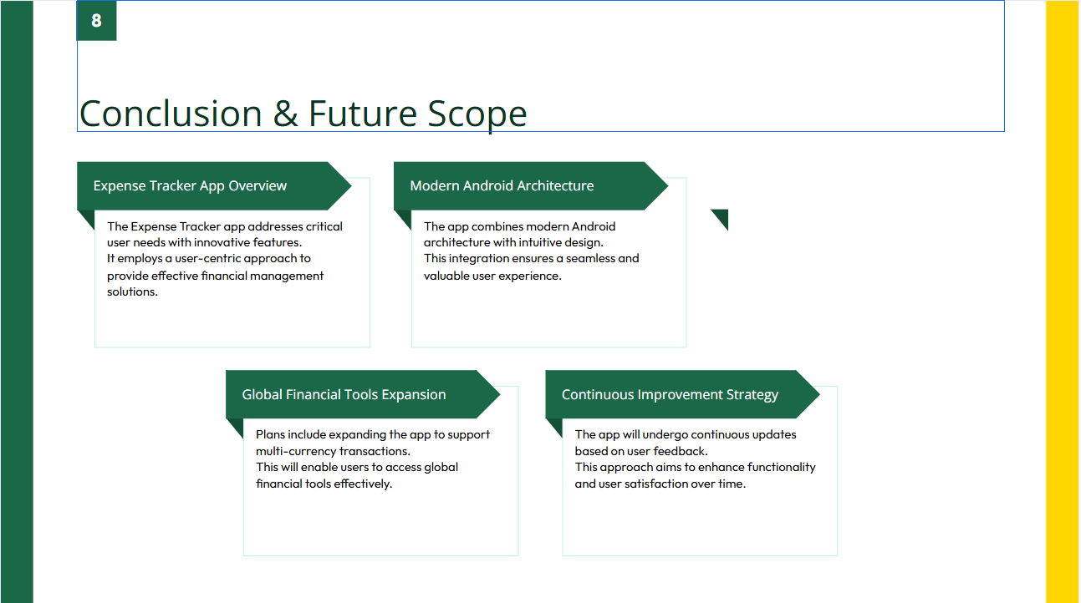

Slide 10


